Slide 1

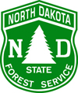

EAB Awareness Week 2017
Notes:
Emerald Ash Borer Awareness Week is a cooperative project between the North Dakota State University Forest Service, NDSU Extension Service and the North Dakota Department of Agriculture. All are working to prepare for the arrival of the Emerald Ash Borer, or EAB. EAB has not arrived yet, but by preparing for it and by keeping North Dakota communities informed, we can reduce the impact of this invasive pest.

Slide 2
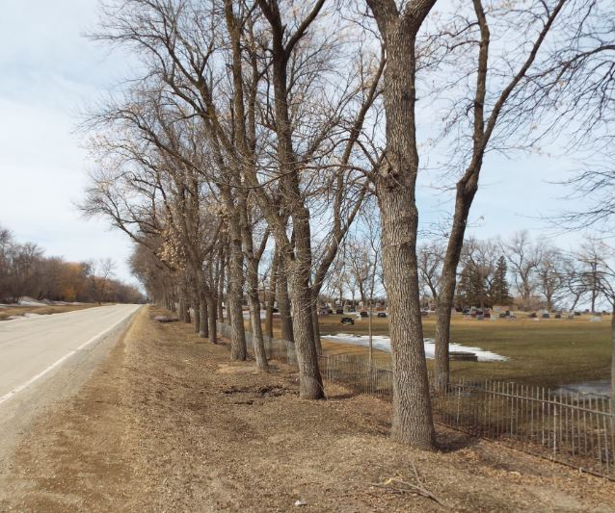
The Threat of
Emerald Ash Borer and
The Benefits of Preparing Your Community
North Dakota Forest Service
May 2017
Notes:
Emerald Ash Borer is expected to spread here and perhaps even farther. North Dakota Communities can prepare for the effects of its arrival.

Slide 3
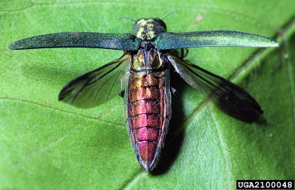
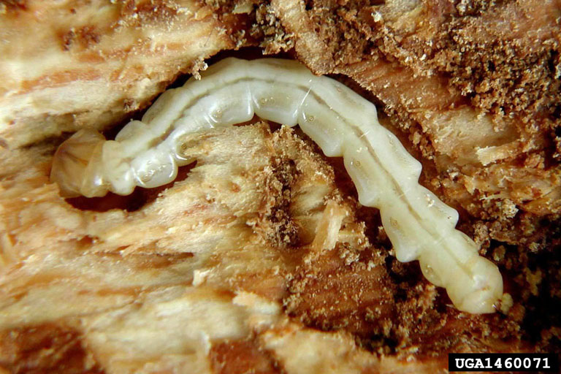
The Threat
  Emerald Ash Borer
  “EAB”
Notes:
According to the USDA, “the emerald ash borer is by far the most destructive invasive exotic species to have arrived in North America in quite some time.”

Slide 4
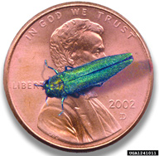
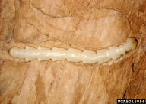
EAB: The Threat
Emerald Ash Borer
Small metallic green beetle
Adult lays eggs on ash bark
Larvae chew tunnels under bark, killing ash trees
Identified 2002 in Michigan
Came from Asia
Rapid spread in North America
No effective native predators
Notes:
The Emerald Ash Borer was discovered in North America in Michigan in 2002.
EAB is a small metallic green beetle. Adult beetles lay their eggs on the bark of ash trees. When the eggs hatch, the larvae chew tunnels under the bark, cutting off the flow of nutrients. This stresses the tree. Soon more borers are attracted to the stressed tree and continue the attack. This kills the tree.
All life stages - larvae, eggs, and pupae - can live through the winter here.
The larvae chew a little farther into the tree to pupate. The adults then chew a D-shaped hole in the bark and emerge, to continue the cycle of destruction.
Emerald Ash Borer has no effective native predators.

Slide 5
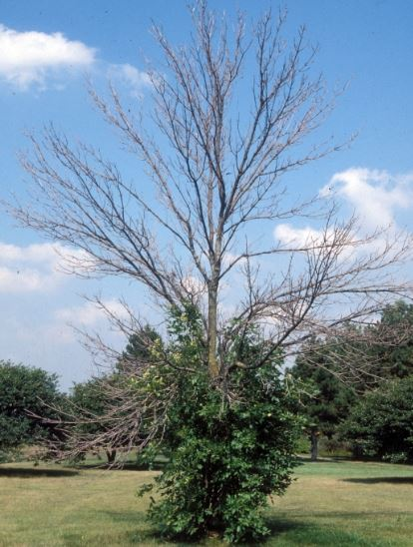
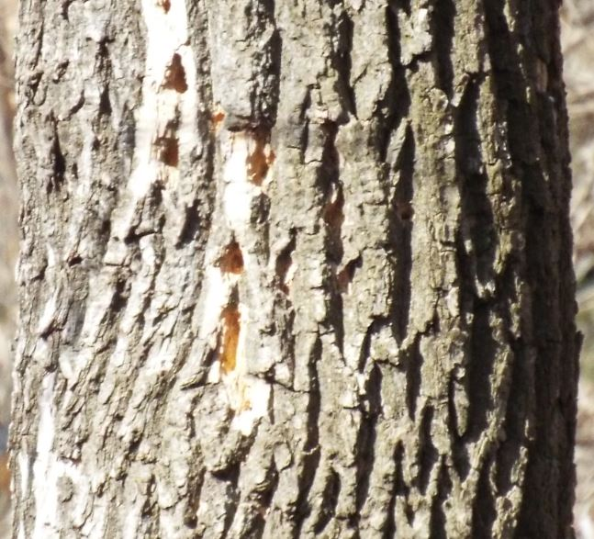
EAB: The Threat
Infested trees decline and die
Woodpecker damage and D-shaped exit holes
Exit hole
Declining crown and sprouting along trunk.
Woodpecker feeding
Notes:
Ash trees which have been attacked by the emerald ash borer will show a declining crown. Foliage will start to look thin, then branches will die, then the entire crown will die. Sprouts may appear on the main trunk as the tree tries to respond to this stress.
Woodpeckers will be attracted to the tree, and will begin excavating for the larvae under the bark. Woodpeckers will pull off bits of bark so that the bark appears lighter in color. Woodpeckers will also excavate dime-sized holes when they are digging out larvae.
Ash trees will respond much the same way to native borers and to environmental stresses. EAB leaves one very distinctive sign:
Adult emerald ash borers will leave 1/8-inch D-shaped exit holes in the bark.

Slide 6
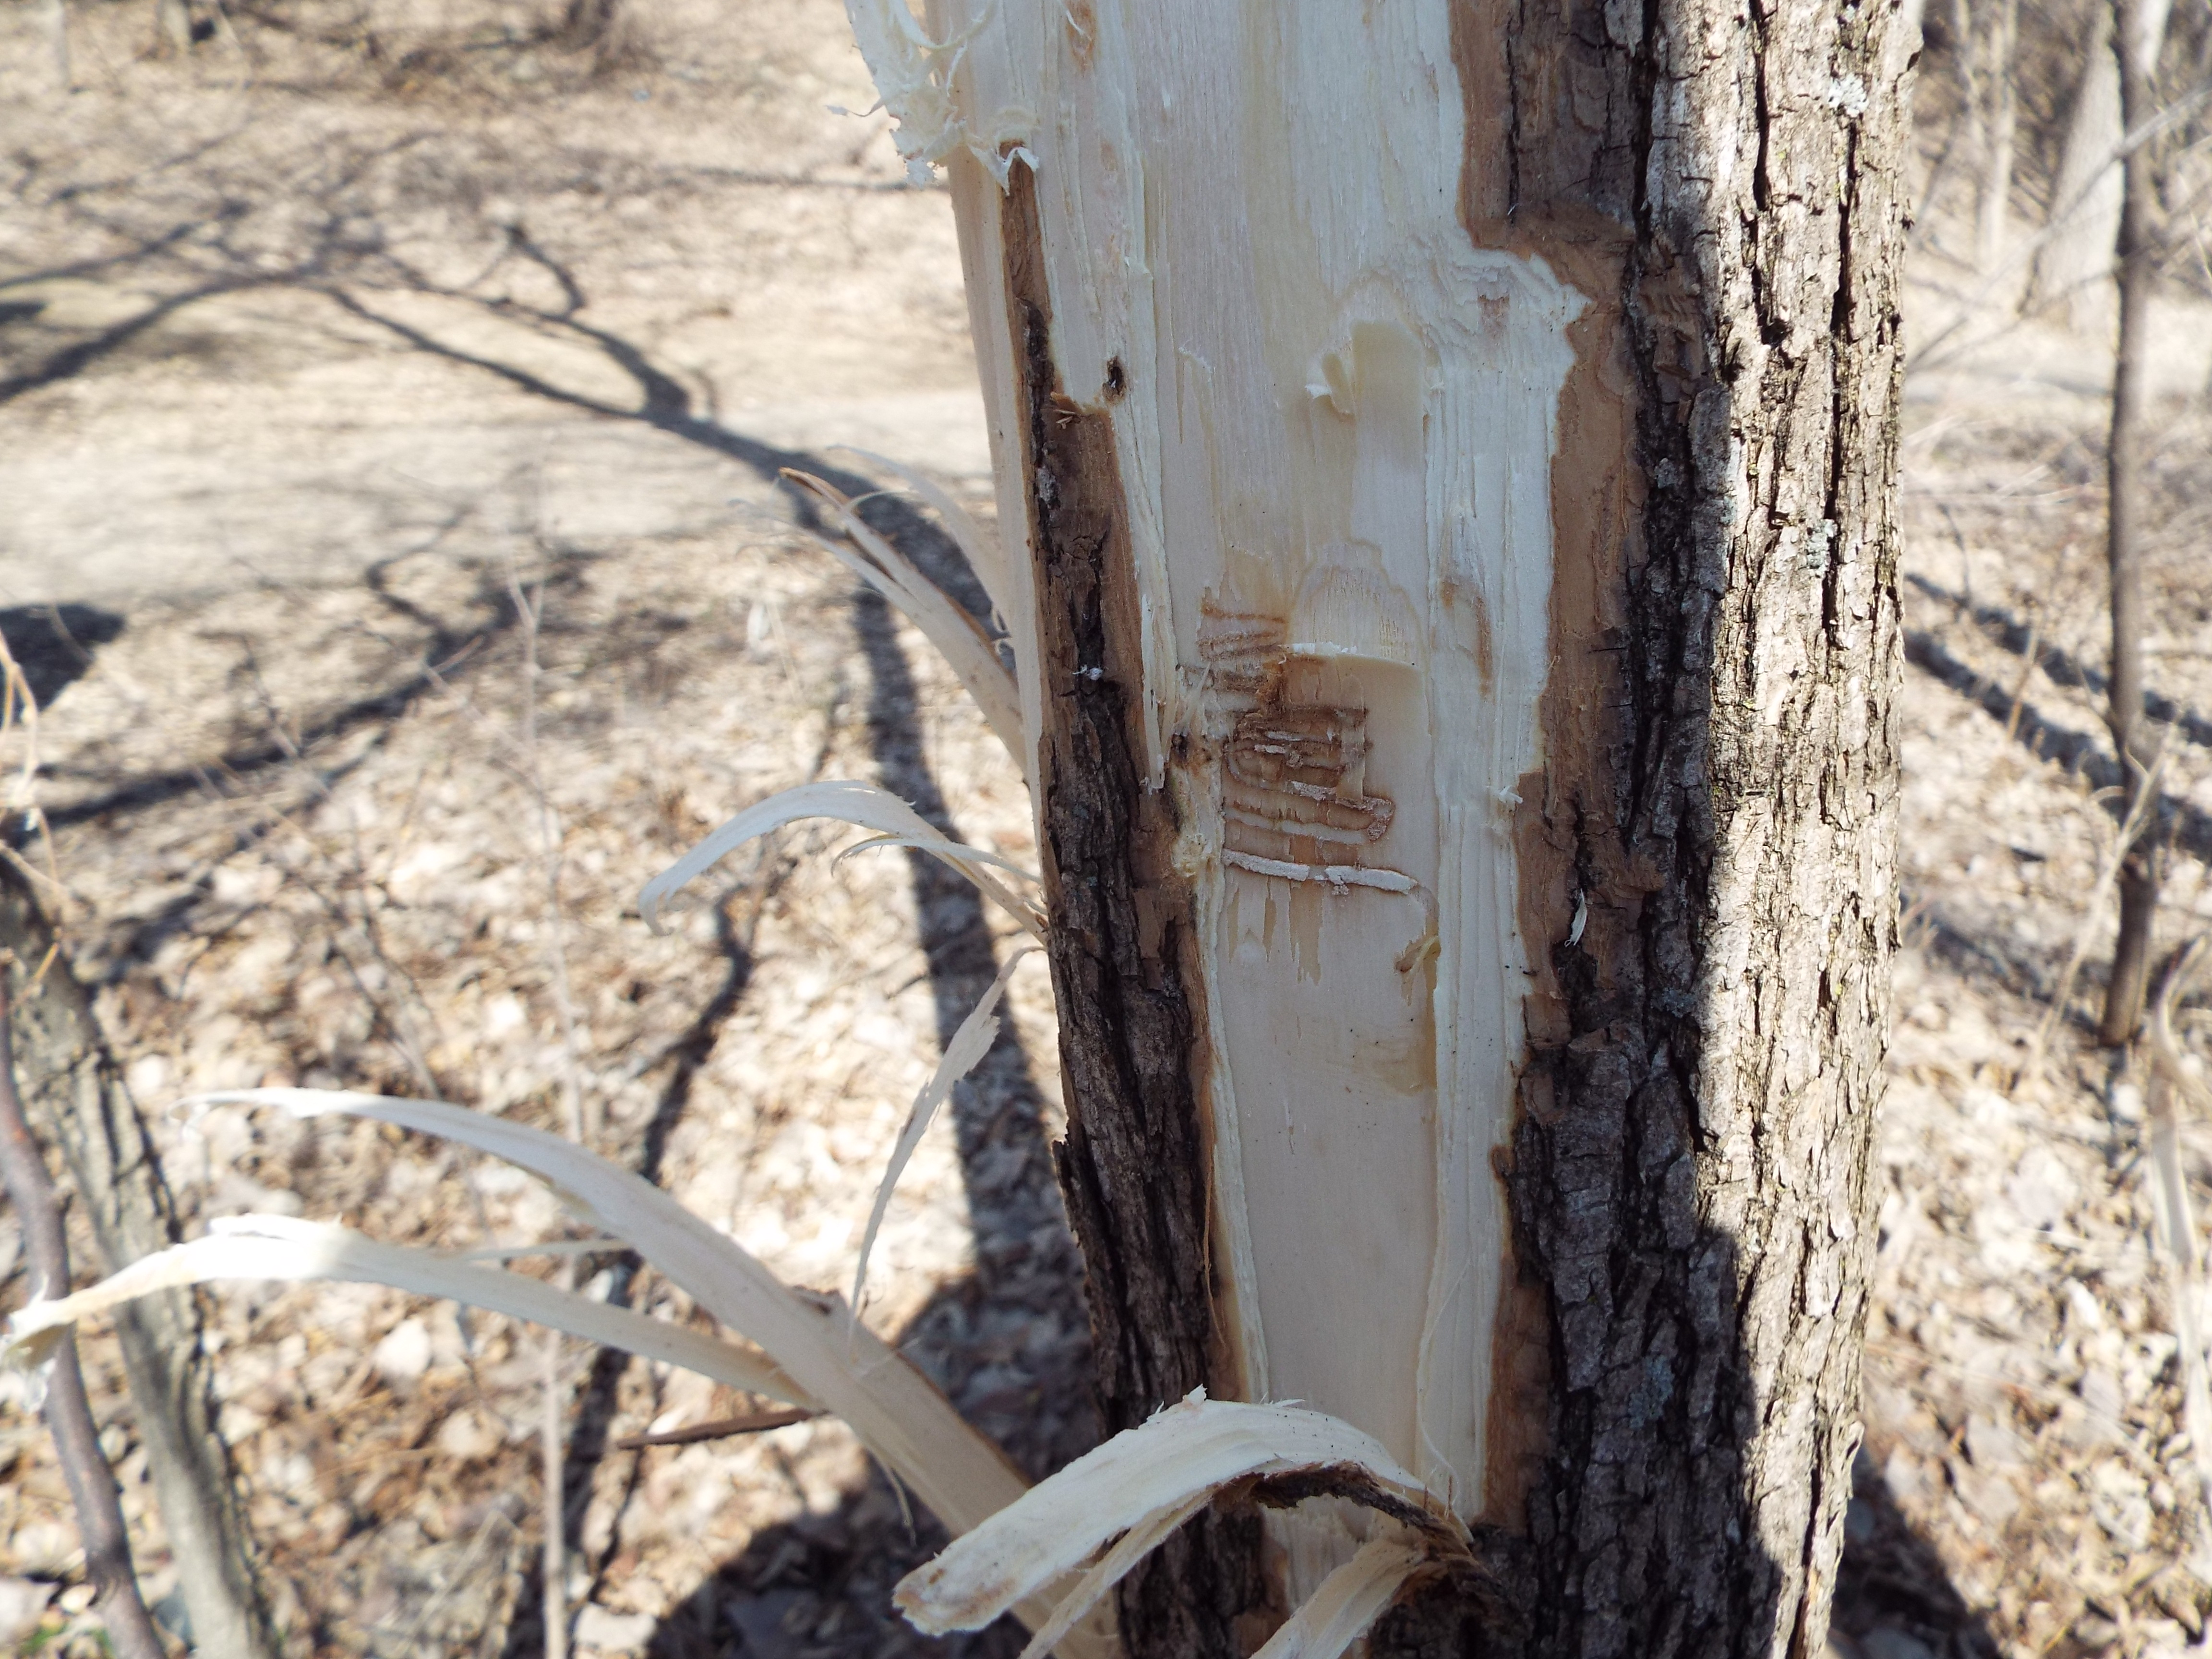
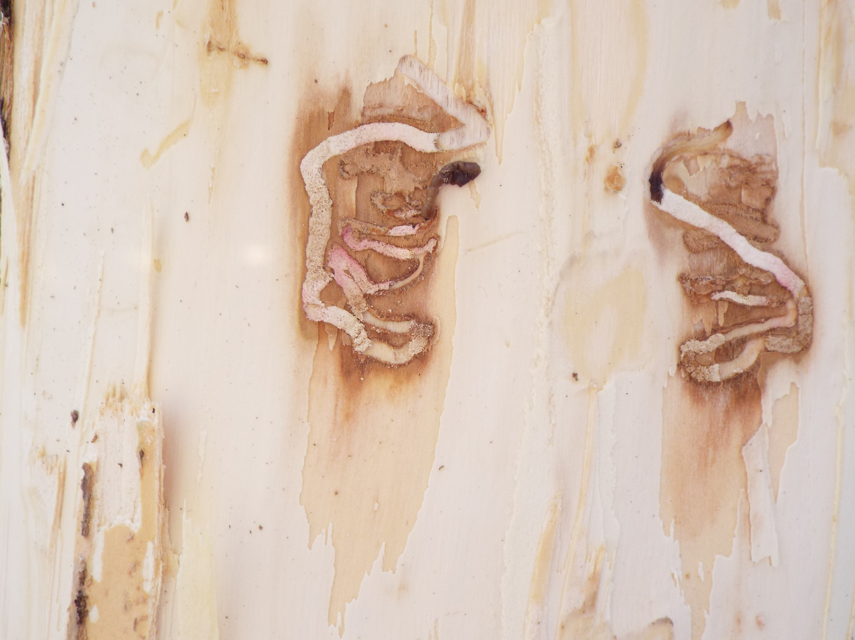
EAB: The Threat
EAB spreads on its own:
Adults can fly about a half mile from their nursery tree.
People take EAB longer distances in infested:
Firewood
Nursery trees
Wood products
Notes:
Emerald Ash Borers can fly, and will lay eggs on trees a half-mile and even up to a mile beyond their home nursery tree. If this were the only way they spread then they would still be within the Detroit metropolitan area right now. The problem is that infested nursery trees, wood products, and especially infested firewood spreads them to new locations. Firewood is the culprit in most new infestations.

Slide 7
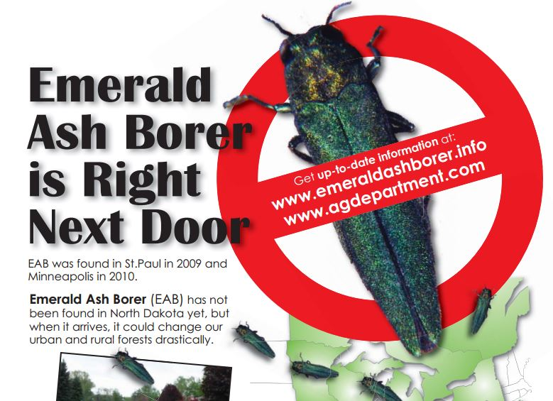
EAB: The Threat
From an EAB Awareness Poster - 2013
Emerald Ash Borer is in the Twin Cities of Minnesota and is spreading.
Notes:
Emerald Ash Borer was found in St. Paul, Minnesota in 2009 and in Minneapolis, Minnesota in 2010. Even with extensive borer monitoring efforts using traps, it can take years for a new infestation to be detected. Meanwhile, the population grows and infests more ash trees.
EAB is now spreading out of the Twin Cities.

Slide 8
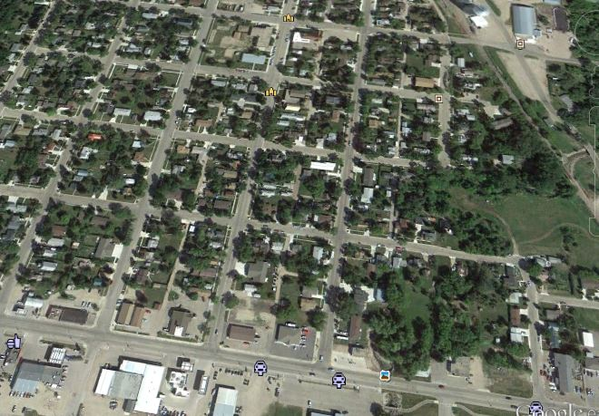
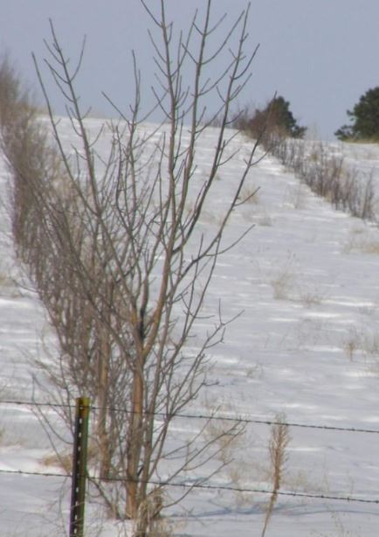
EAB: The Threat
All of North Dakota’s 78 million ash trees are vulnerable
Ash are commonly planted in shelterbelts.
Nearly half of the trees in North Dakota cities are ash trees
Notes:
Green ash is a North Dakota native and is an important part of forests. It has also been planted extensively in cities and in rural plantings, like windbreaks and shelterbelts. White ash, black ash and Manchurian ash have also been planted in cities. All these ash trees are susceptible to the emerald ash borer. Mountain ash, which is in the genus ‘Sorbus’ is not a true ash and is therefore not susceptible to EAB.
North Dakota cities which have been surveyed have as low as 20 percent ash and as high as 80 percent. Just under half the cities surveyed had about fifty percent ash.

Slide 9
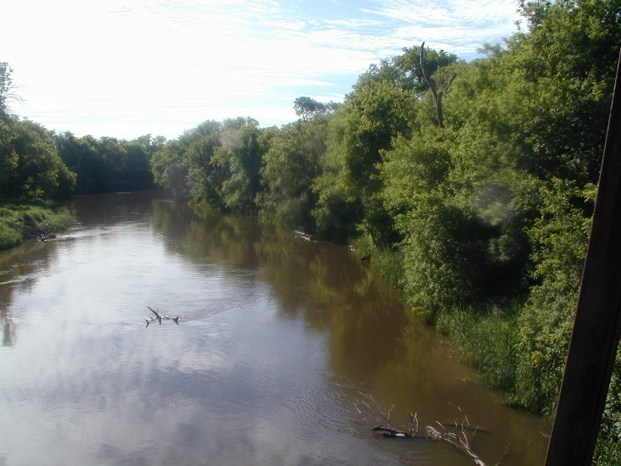
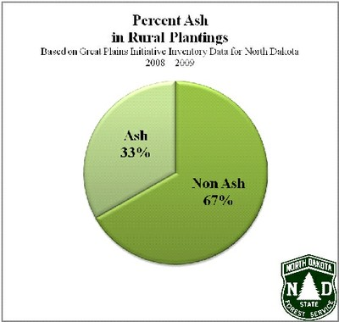
EAB: The Threat
All of North Dakota’s 78 million ash trees are vulnerable
Ash makes up over two-thirds of our native riparian forests.
About a third of all trees u planted in rural North Dakota are ash.
Notes:
Forests along rivers and streams are called riparian forests. These are some of the largest forest tracts in North Dakota. Riparian forests are made up of about 65 percent ash trees and will be greatly affected by EAB.
This could have a negative impact on water quality and aquatic life.
About a third of all trees planted in rural North Dakota are ash trees. A larger proportion of ash is usually planted closer to homesteads.

Slide 10
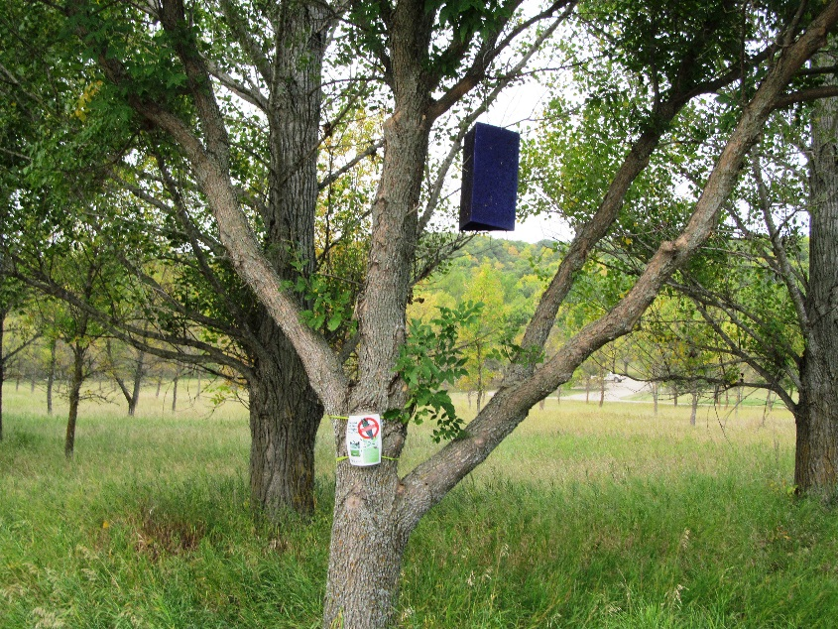
EAB: The Threat
All ash trees are vulnerable
Effective predators and biological control are not readily available
Eradication is unlikely
Quarantines are ineffective
Ash trees will be killed in North Dakota’s cities, windbreaks, forests, and anywhere they now grow
EAB trap in ash tree
How big a problem is EAB?
EAB is now considered the most destructive forest pest ever seen in North America.
Notes:
State and federal agencies have been working on understanding EAB and finding ways to slow or stop its destruction ever since it was first identified in North America. Federal and state quarantines have not contained the spread of the insect. Predators and parasites from its native range are being tested at infestation sites.
An extensive trapping and monitoring program is in place to detect new infestations.
Insecticides can effectively treat and prevent EAB infestation in individual trees, but are a waste of time and money if applied before the insect has been detected within 15 miles of the tree’s location.

Slide 11
EAB: Benefits of Preparing Your Community
Minimize EAB impact on your community forest
Dead trees are liabilities
Make the best cost/benefit decisions for public and for private ash trees
  Treat (only when within 15 miles)
  Remove and replace (budget $400 to $2500 per tree, depending on size)
Have a plan to:
  Stop the spread of emerald ash borers
  Dispose of or use infested wood
  Keep everyone informed
Notes:
We can minimize the impact of EAB on our community forest and on our budgets by planning for it.
We can plan to make the best cost/benefit decisions for both public and private trees.
We can plan to dispose of infested wood in ways that will help stop the spread of EAB.
We can help everyone in our community understand what we are doing about EAB and what they can do to help.
EAB has not been found in North Dakota, so treating now is a waste of time and money. Preparing and prevention are key.

Slide 12
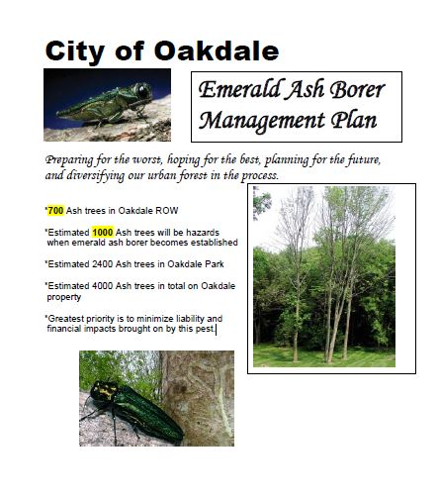
EAB: Benefits of Preparing Your Community
Plan to manage EAB impact
Notes:
An EAB preparedness plan can help improve our community forest and prepare it for the arrival of any destructive pest.

Slide 13
EAB: Benefits of Preparing Your Community
Your EAB Plan can include:
Tree inventory
Preemptive removals
Increase species diversity
Tree ordinance
EAB ordinance
Tree contractor qualifications
Using and disposing of wood
Communication plan
Notes:
An inventory will tell your community what trees you have now and how vulnerable your community is to tree pests. Removing the poorest quality trees, especially ash trees, and replacing them with a diversity of species will improve overall tree quality.
Since ash borers travel on firewood, restricting firewood imports from other states will help delay the spread of EAB. Make sure local businesses are not importing firewood from quarantined areas.
Tree ordinances and EAB ordinances are good community planning tools. Ordinances specify which trees are good choices for planting in a community. They can also spell out who is responsible for maintenance and tree removal for boulevard trees.
Pay attention to tree contractor qualifications and to the proper use or disposal of wood, especially in the case of an infestation. And, make sure you communicate well with citizens.

Slide 14
EAB: Benefits of Preparing Your Community
Make the best cost/benefit decisions now:
Preemptively remove ash trees that are in poor condition.
Plant a variety of well-adapted tree species to increase tree diversity.
Develop or update your city tree ordinance now.
When EAB is within 15 miles – decide whether or not to treat valuable specimens.
Notes:
Preemptive removals are often part of EAB plans because they help reduce the number of trees available for EAB to attack. Start with the poorest condition ash trees for removals. Then plant a variety of well-adapted trees to improve the diversity of your community forest. This helps spread the cost of tree removals over more budget years, and improves the condition of the community forest.
Review and update your tree ordinance, or write a new one if needed.
When EAB arrives, it will be best if you already know which trees you need to protect. Otherwise you may be wasting dollars and time.
Make sure EAB information comes from a reliable source, not necessarily from a company which would like your business.

Slide 15
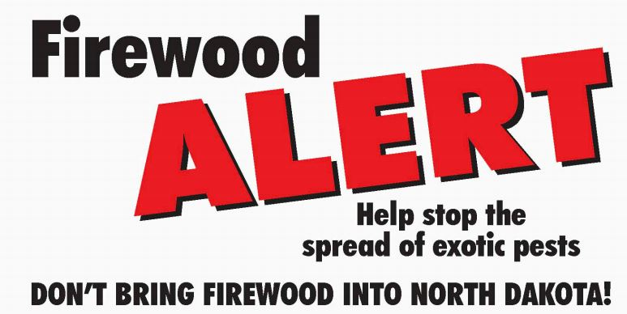
EAB: Benefits of Preparing Your Community
Help prevent and stop the spread of EAB.
Notes:
Don’t move firewood into North Dakota.
Know the symptoms of EAB infestation: Crown decline, sprouting along the trunk, woodpecker excavations, and D-shaped exit holes.

Slide 16
EAB: Benefits of Preparing Your Community
If you suspect EAB:
  North Dakota Forest Service (701) 231-5138
  North Dakota Department of Agriculture (701)220-0485
  NDSU Extension Service (701)231-8143
  NDSU Plant Diagnostic Laboratory (701)231-7854 or 231-7064
  Local city forester
  Local county Extension Agent
Notes:
Don’t move firewood into North Dakota.
Know the signs of EAB infestation: Crown decline, sprouting along the trunk, woodpecker excavations, and D-shaped exit holes. Call if you suspect EAB.

Slide 17
EAB: Help for Preparing Your Community
NDFS Community Forestry Program
Community Forest
Grants for tree planting
Grants for Community Forestry program development
EAB ordinance template
EAB plan outline and guidelines
Community Forestry Specialists
NDFS Forest Stewardship Program
Assistance for rural landowners
Notes:
Your community can get help with its trees from the North Dakota Forest Service. The Community Forestry Program offers a quick inventory to assess the threat of a tree pest like EAB, recommendations for improving the health of your community forest, grants for tree planting and for program development, and other assistance. Community Forestry Specialists can work one-on-one with your community.
Rural landowners can receive assistance through the NDFS rural forestry programs.

Slide 18
Rhymes aren’t boring!
In our forests there’s a horror,
Approaching from the east
It’s called the Emerald Ash Borer,
On ash trees it does feast.
It eats xylem but mostly phloem,
While hiding under bark.
And when the beetle emerges,
It leaves a D-shaped mark.
It is coming to North Dakota,
To kill our ash trees dead.
Those who care about our forests
Don’t cry. We plan instead.
We face a borer invasion.
We have to figure out.
Can we balance the equation?
We have options, no doubt.
Let’s prepare for this invader.
Let’s learn what’s being done.
Our response will be much greater
If planned for the long run.
Make an emerald ash borer plan
In response to this threat.
Increase our tree diversity
And come out better yet!

Slide 19
Review
Emerald Ash Borer is a wood boring insect.
EAB kills ash trees.
EAB is in North America and is spreading.
EAB spreads on wood products like firewood.
North Dakota is vulnerable.
North Dakota communities can plan now to reduce the impact of EAB.
Help is available from the North Dakota Forest Service.

Slide 20
More Information
North Dakota Forest Service http://www.ndsu.edu/ndfs/
NDSU Extension http://www.ag.ndsu.edu/extension
North Dakota Department of Agriculture http://www.nd.gov/ndda/
ND Invasives (invasive tree pests) http://www.ndinvasives.org

Slide 21
Citations
Cover, galleries, woodpecker damage, rhyme: L Johnson, NDFS.
EAB with wings out: David Cappaert, www.insectimages.org
First EAB larva: David Cappaert, Michigan State University, www.Bugwood.org
EAB on penny: Howard Russell, Michigan State University, www.insectimages.org
EAB larva: Pennsylvania Department of Conservation and Natural Resources - Forestry Archive, www.insectimages.org
Declining ash tree: Daniel Herms, The Ohio State University, www.Bugwood.org
EAB poster: NDSU Extension
Aerial view: Google Earth
Shelterbelt, riparian forest, EAB trap: NDFS
City of Oakdale Plan: City of Oakdale, MN

